Slide 1



WEB DEVELOPMENT

Slide 2

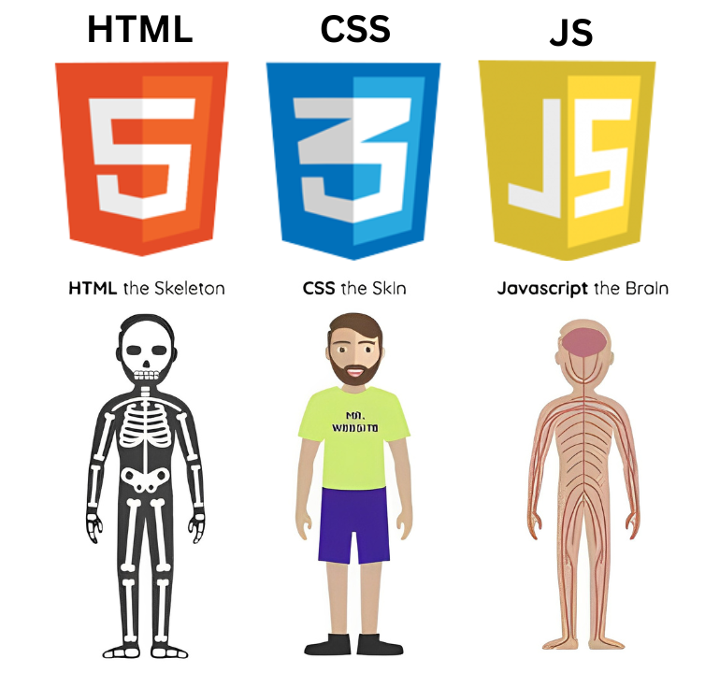

WHAT IS A WEBSITE MADE UP OF?
HTML: The skeleton – provides structure.
CSS: The skin and style – defines appearance.
JavaScript: The brain – adds behavior and interactivity.

Slide 3



HTML

Slide 4
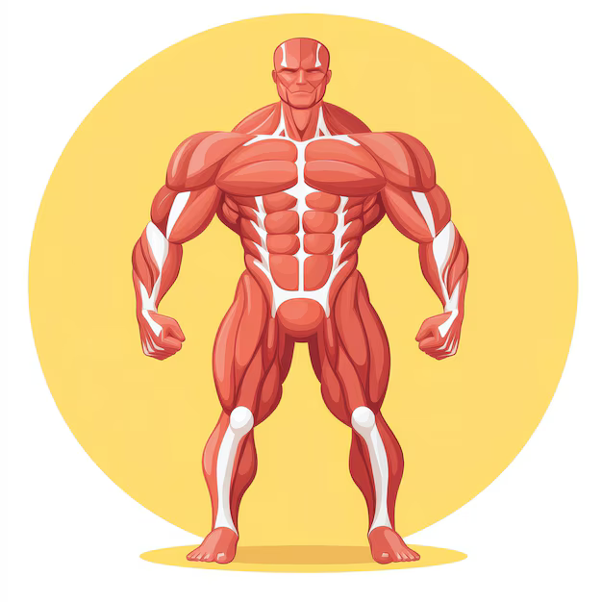
CSS

Slide 5
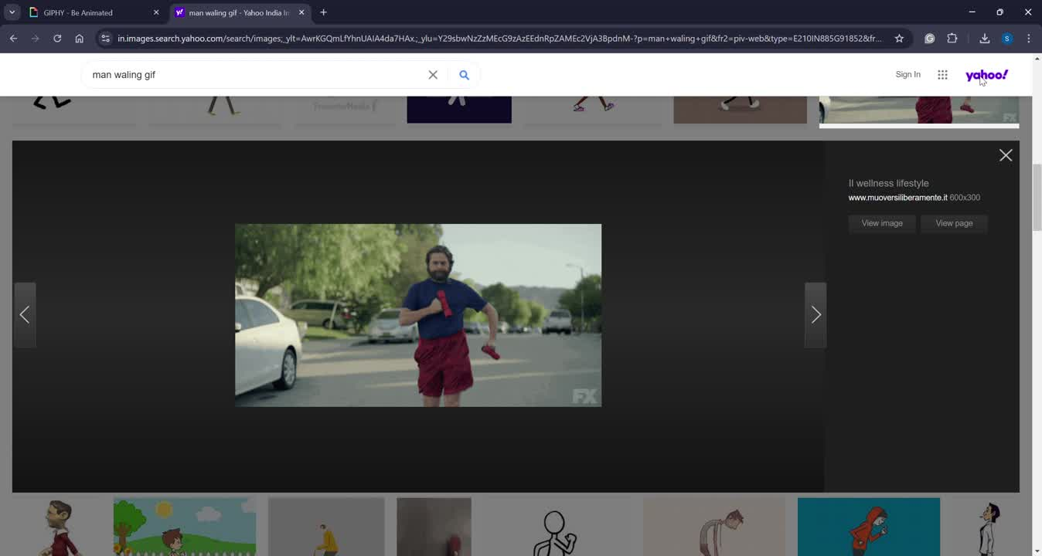
JAVASCRIPT

Slide 6

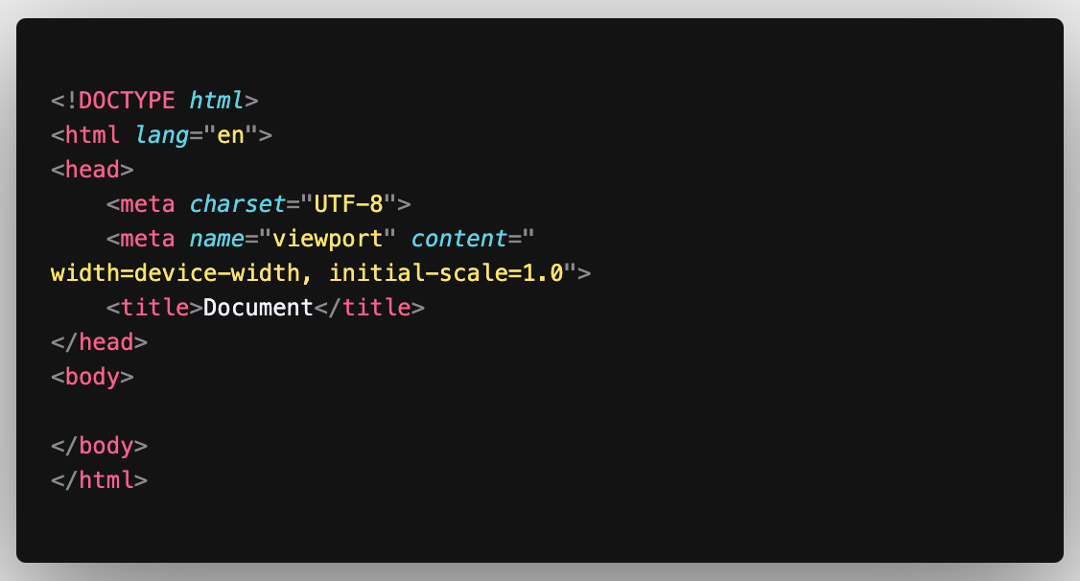

HTML-BOILER PLATE

Slide 7

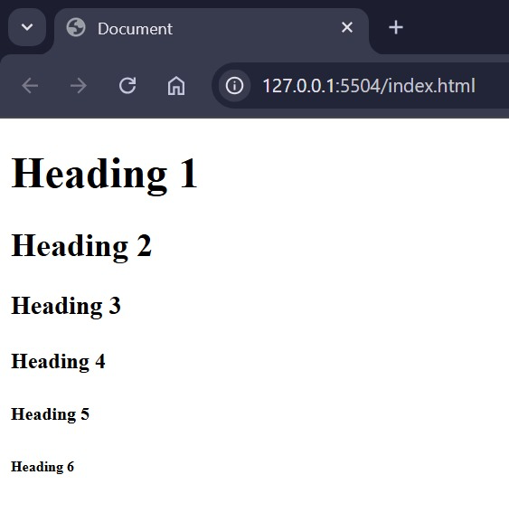
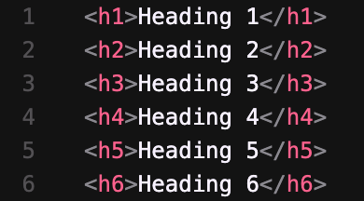
HTML TAGS
Heading tag:

Slide 8
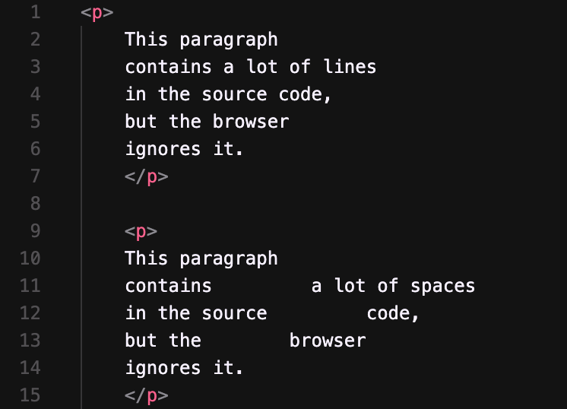
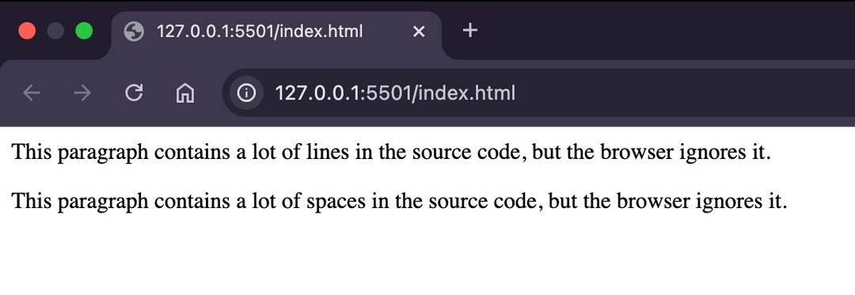
HTML TAGS
Paragraph tag:

Slide 9
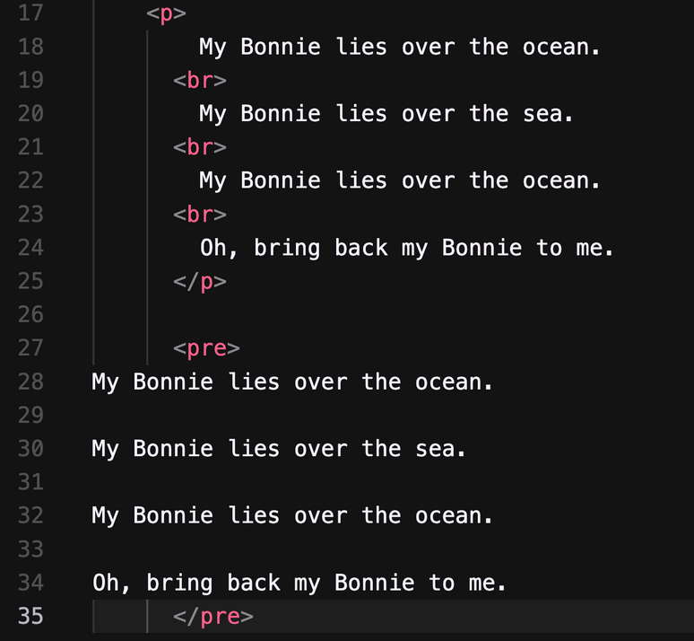
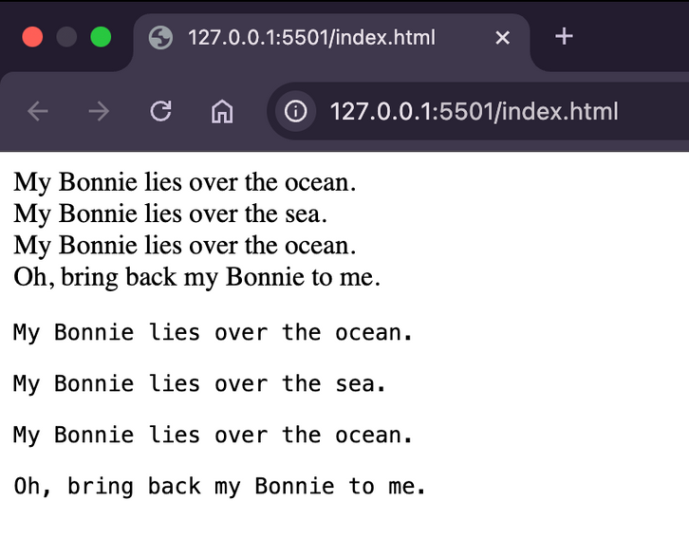
HTML TAGS
Paragraph tag:

Slide 10
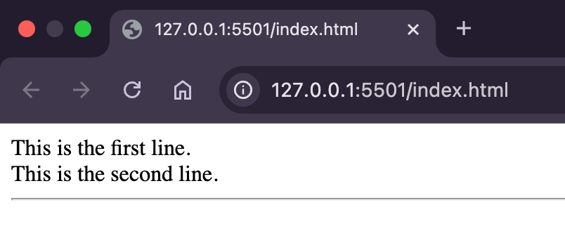
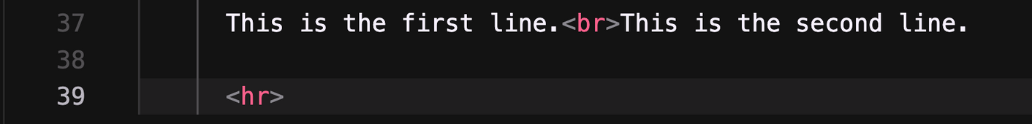
HTML TAGS
Line Break & Horizontal Rule

Slide 11
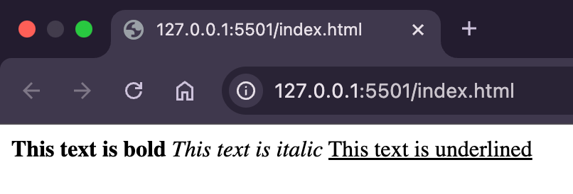
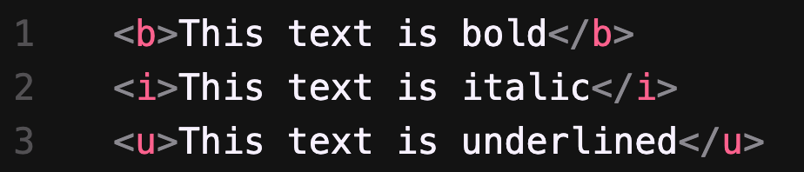
HTML TAGS
Formatting Text

Slide 12
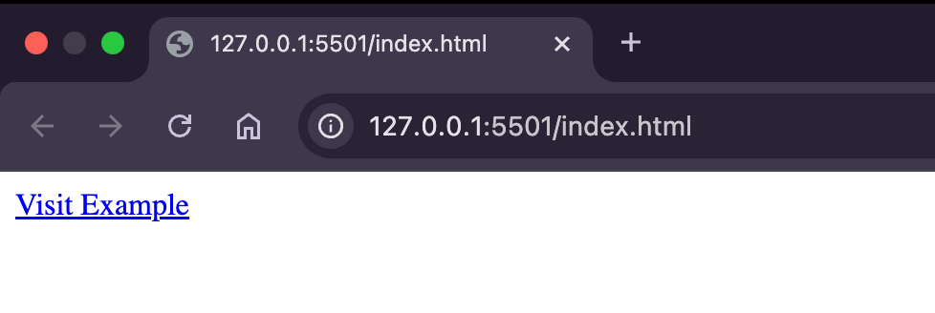
HTML TAGS
Links and Navigation

Slide 13
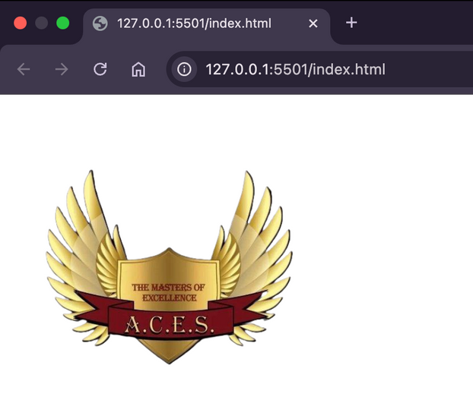
HTML TAGS
Images

Slide 14
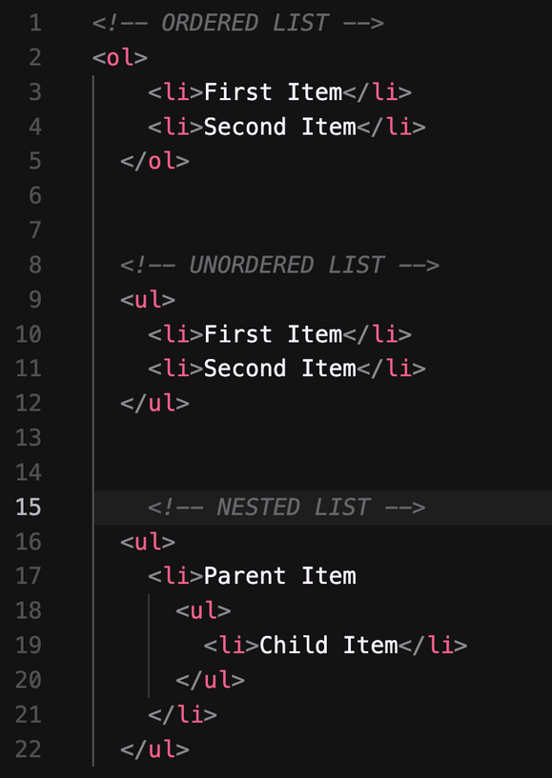
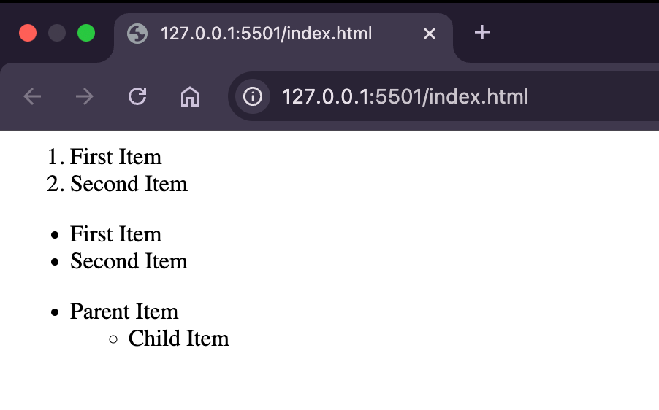
HTML TAGS
Lists

Slide 15
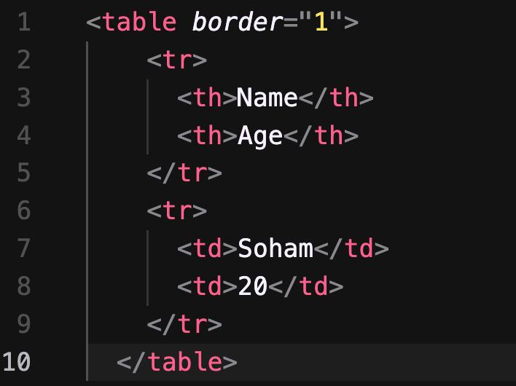
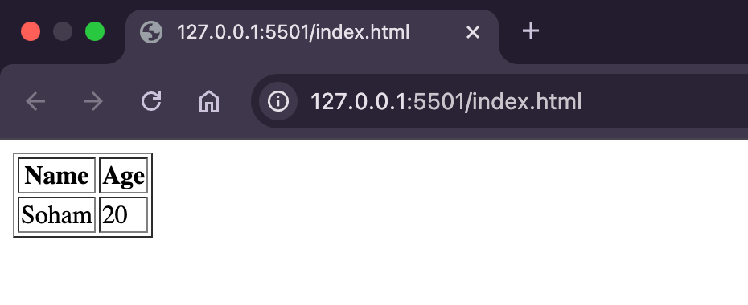
HTML TAGS
Table

Slide 16
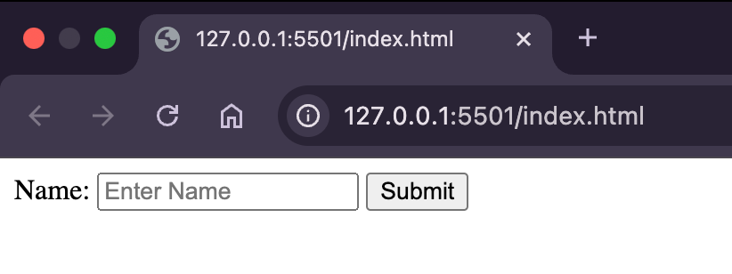
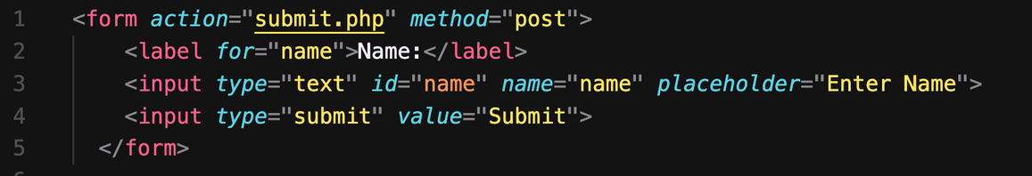
HTML TAGS
Forms

Slide 17
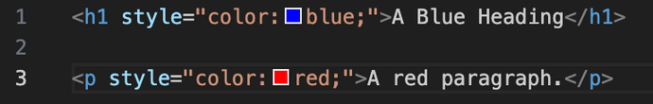
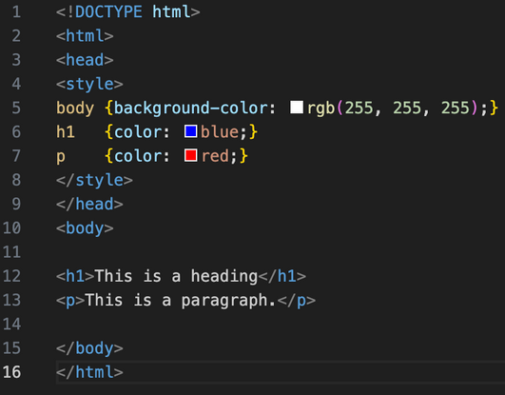
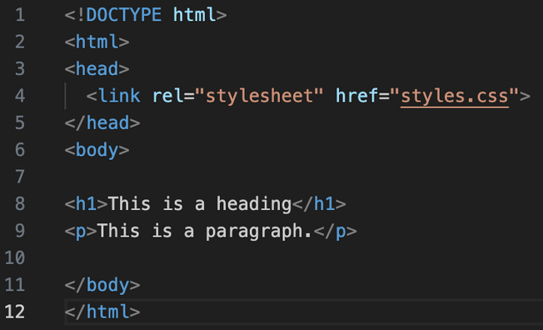


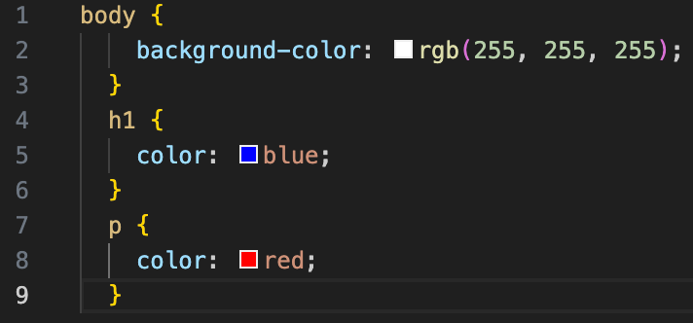
HTML & CSS

Slide 18
HTML & CSS
Inline
Internal
External

Slide 19
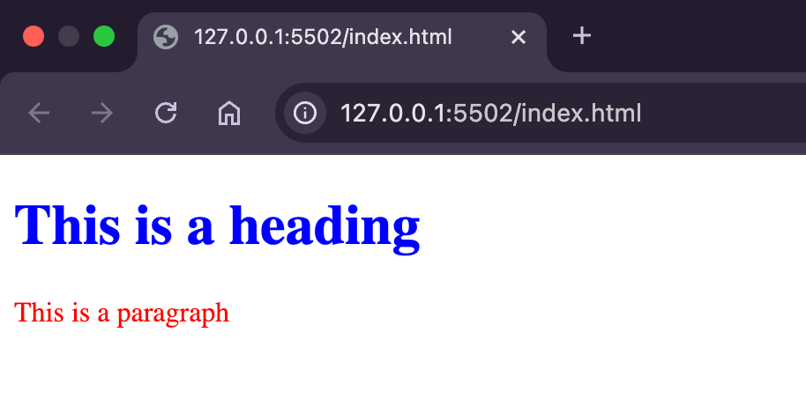
HTML & CSS

Slide 20
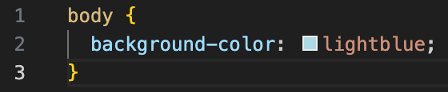
CSS SYNTAX
Selector
Property
Value

Slide 21
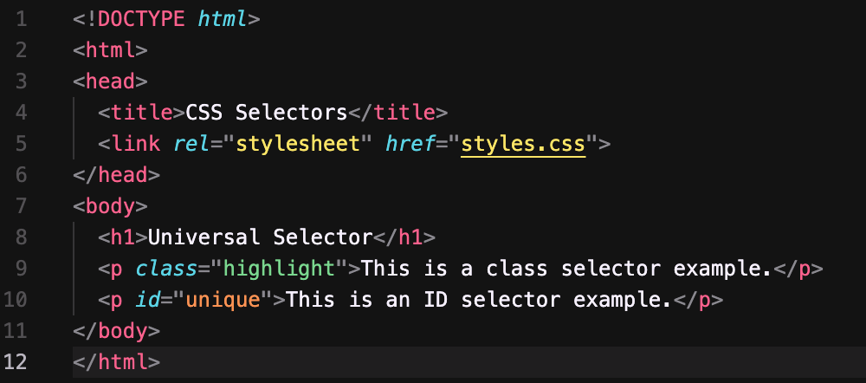
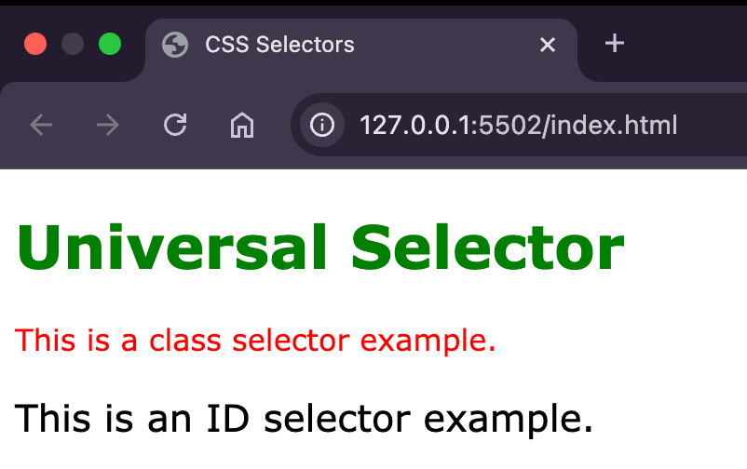
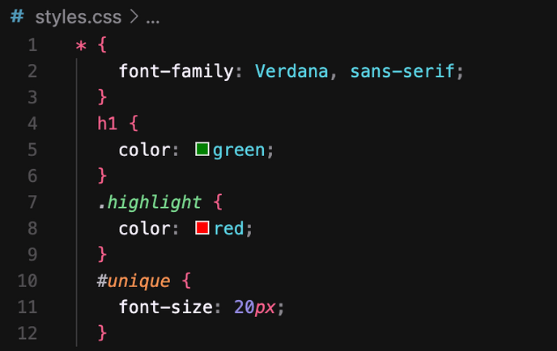
CSS: SELECTORS
Selectors:
Universal: *
Class: .class_name
ID: #id_name

Slide 22
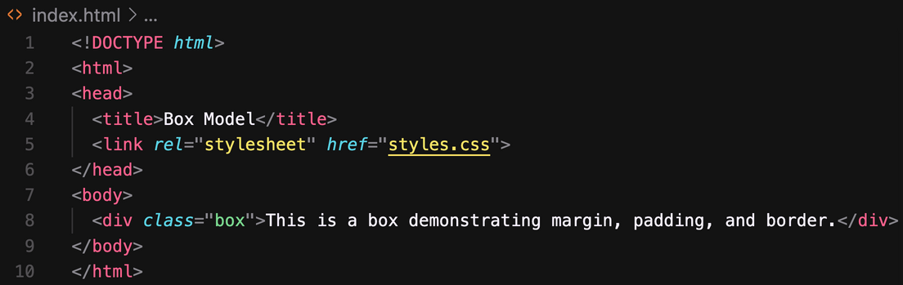
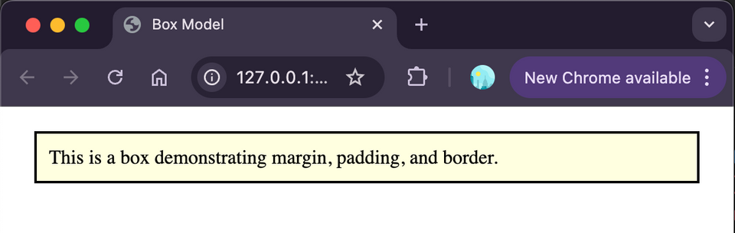
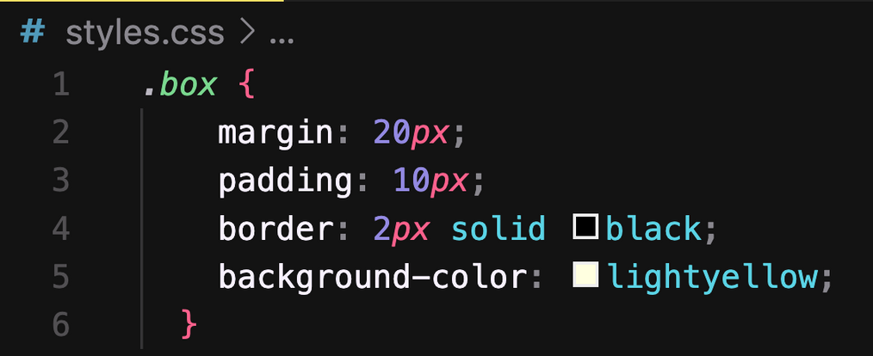
CSS: MARGINS, PADDING, AND BORDERS

Slide 23
DAY 2

Slide 24
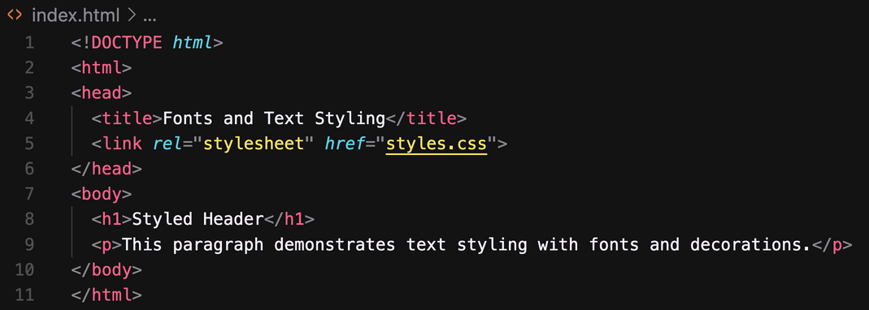
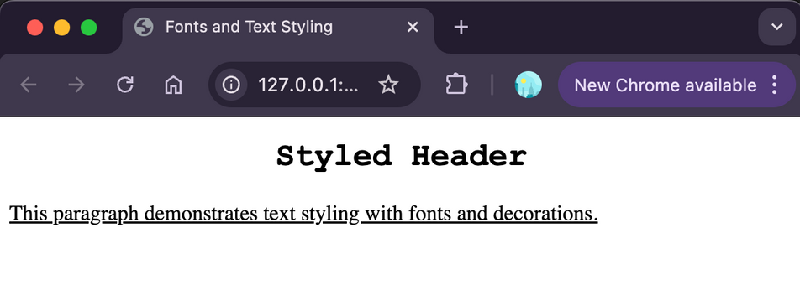
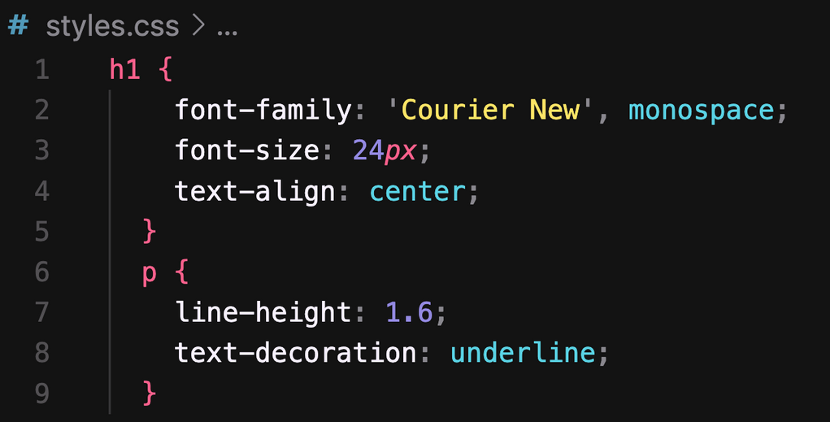
CSS:FONTS AND TEXT STYLING

Slide 25
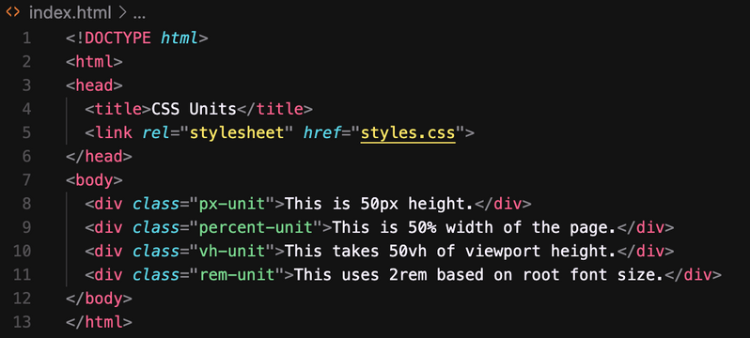
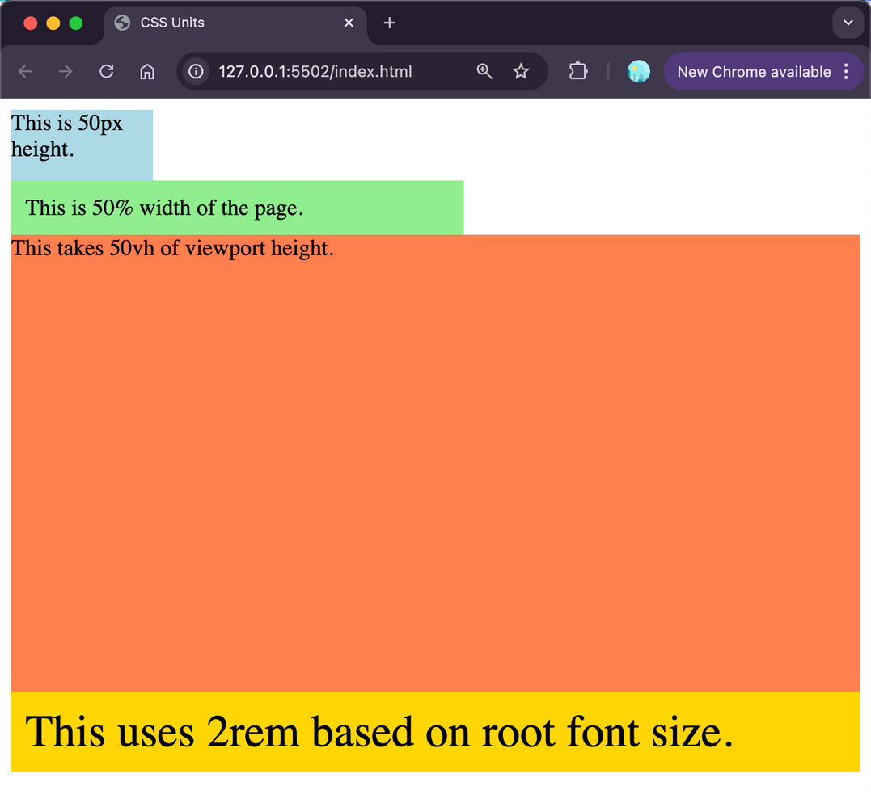
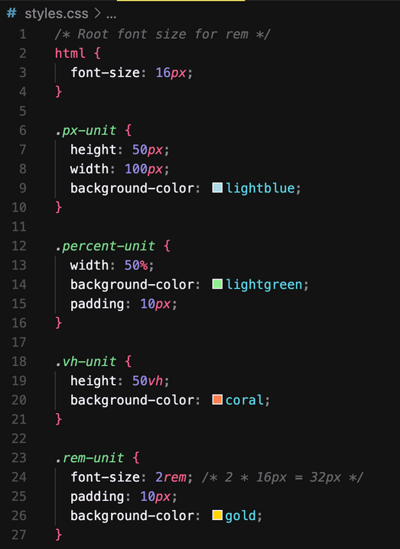
CSS: UNITS

Slide 26
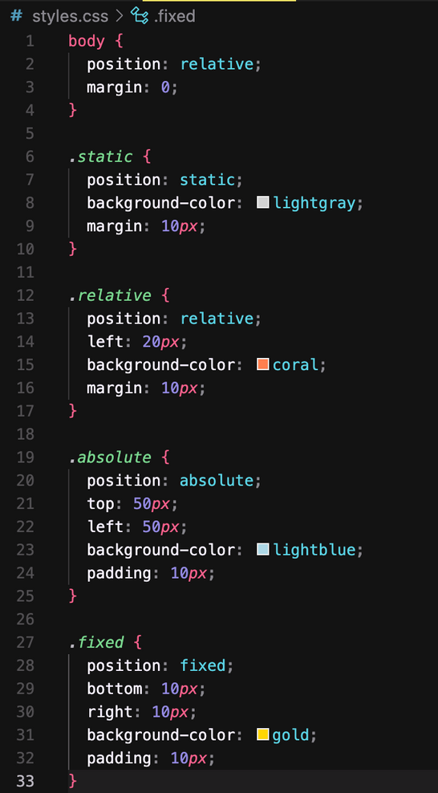
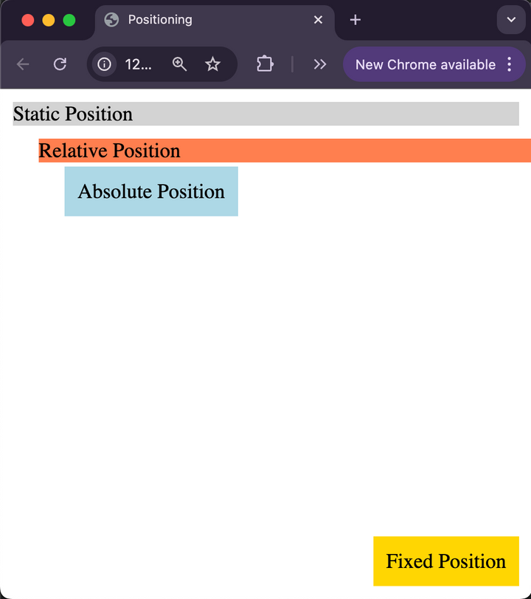
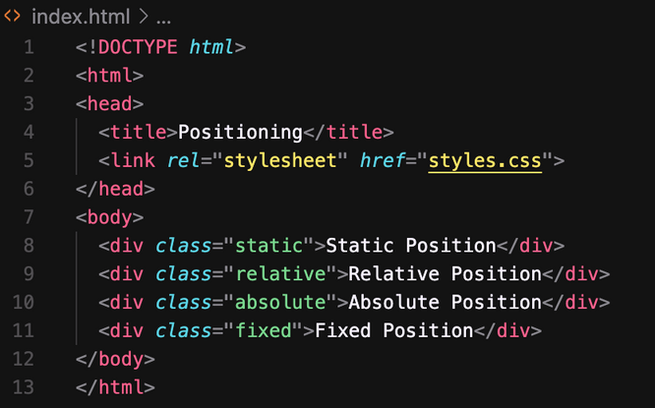
CSS: LAYOUTS- POSITIONING

Slide 27
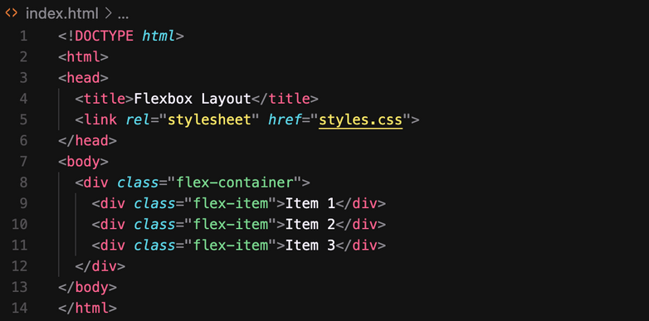
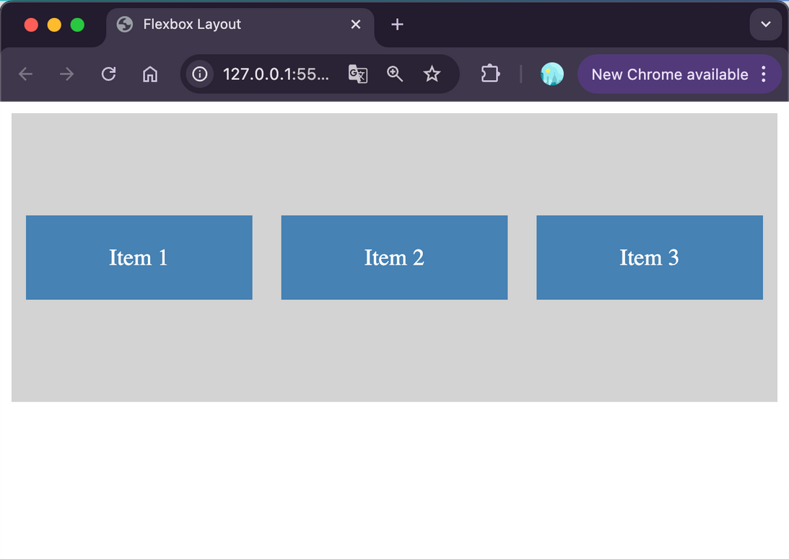
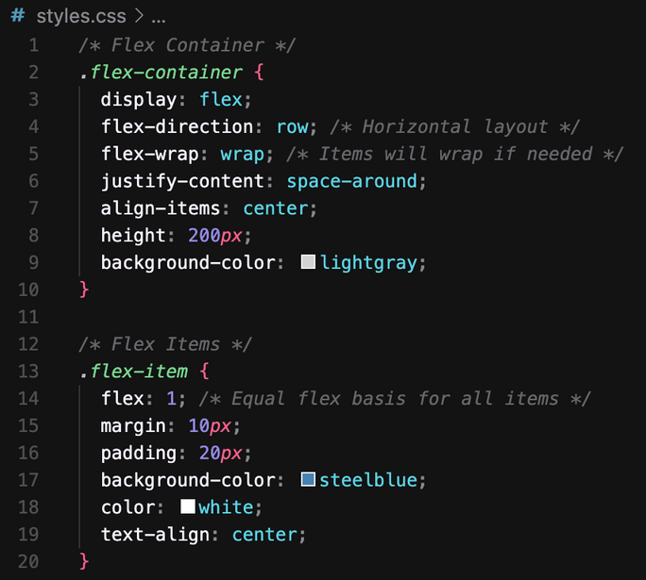
CSS: LAYOUTS- FLEX

Slide 28
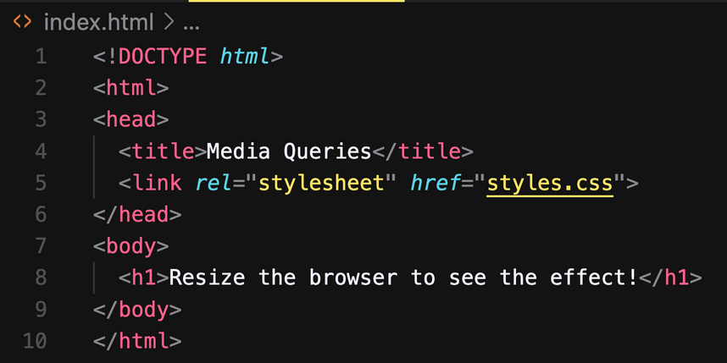
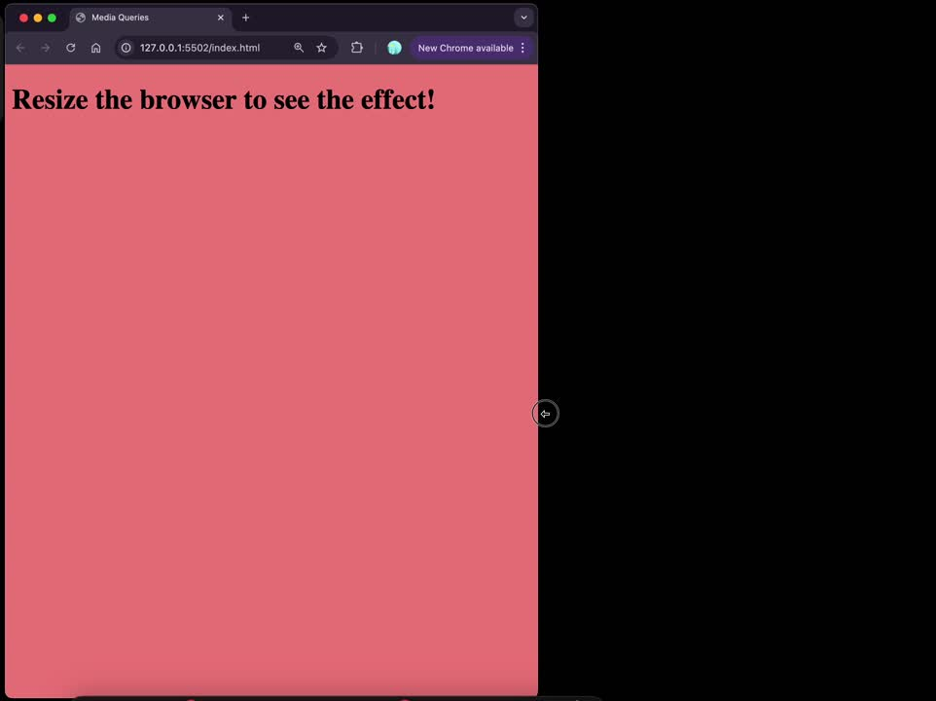
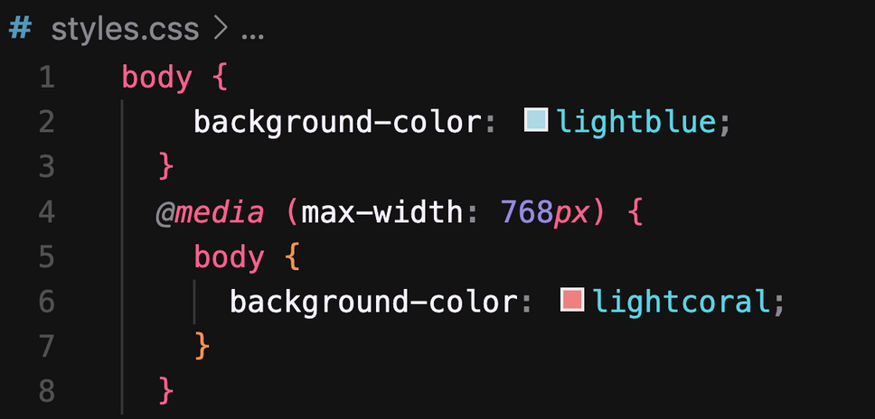
CSS: MEDIA QUERIES
max-height, min-width, min-height

Slide 29
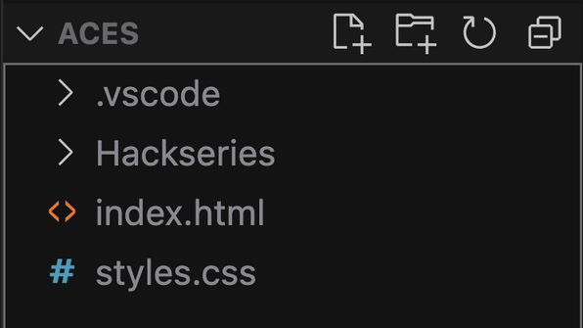


BEST PRACTICES

Slide 30
DAY 4

Slide 31
JAVASCRIPT

Slide 32

JS & HTML

Slide 33
JS- WORD VS KEYWORD
Aspect | word | keyword
Definition | Any string or identifier in JavaScript. | Reserved words with specific meanings.
purpose | Used as names for variables, functions, etc. | Used to define JavaScript syntax or logic.
example | myVar, calculate, userName | if, else, let, const, return
restriction | Can be user-defined and custom. | Cannot be used as identifiers or variables.

Slide 34


JS- VAR, LET, CONST

Slide 35




JS- HOISTING

Slide 36


JS- TYPES
Primitive
Referenced

Slide 37


JS- CONDITIONALS
if
else
else if

Slide 38


JS- LOOPS
while
for

Slide 39


JS- FUNCTIONS

Slide 40


JS- ARRAY

Slide 41


JS- OBJECT

Slide 42
JS- DOM
Document Object Model
Four pillars of DOM:
1) Selection of a element
2) Changing HTML
3) Changing CSS
4)Event Listener

Slide 43


DOM- SELECTION OF A ELEMENT
Purpose: To identify and select specific elements in the DOM for manipulation.
Types:
• By ID: document.getElementById()
• By Class: document.getElementsByClassName()
• By Tag Name: document.getElementsByTagName()
• By CSS Selector: document.querySelector() and document.querySelectorAll()

Slide 44




DOM- CHANGING HTML
Purpose: Modify the structure or content of the selected elements..
Types:
• Changing inner content: .innerHTML or .textContent
• Changing attributes: .setAttribute() or .removeAttribute()

Slide 45



DOM- CHANGING CSS
Purpose: Alter the styling of selected elements..
Types:
• Inline CSS: Modify styles using .style
• Add/Remove Classes: Use .classList.add(), .classList.remove(), .classList.toggle()

Slide 46


DOM- EVENT LISTENER
Purpose: Respond to user interactions or other events..
Types:
• Mouse Events: click, mouseover, mouseout
• Keyboard Events: keydown, keyup
• Form Events: submit, change, focus
• Other Events: load, resize

Slide 47





Hackseries 01
React JS

Slide 48



Introduction to React
What is React?
Working of DOM
Problems with JS
Working of React
JS Vs React
Intro to Components

Slide 49


HTML is required for React
CSS is required for React
JS is required for React

Slide 50





1. What is React
JavaScript library to build Dynamic and interactive user interfaces
Developed at Facebook in 2011.
Currently most widely used JS library for front-end development.
Used to create single page application (page does not re-load).

Slide 51


2. Working of DOM
Browser takes HTML and create DOM.
JS helps us modify DOM based on user actions or events.
In big applications, Working with DOM becomes complicated

Slide 52


3. Problems with JavaScript
React has a simpler mental model
JS is cumbersome
JS is Error-prone
JS is Hard to maintain

Slide 53

4. Working of React
No need to worry about querying and updating DOM elements.
React creates a web page with small and reusable components
React will take care of creating and updating DOM elements.
IT saves a lot of time, cheezein aasan hai, pahele se likhi hui hain

Slide 54
5. JS Vs React
JS is imperative: You define steps to reach your desired state.
React is Declarative: You define the target UI state and then react figures out how to reach that state.

Slide 55


6. Introduction to Components
Components help us write reusable, modular and better organized code.

Slide 56

6. Introduction to Components
React application is a tree of components with App Component as the root bringing everything together.

Slide 57

Introduction Revision
What is React?
Working of DOM
Problems with JS
Working of React
JS Vs React
Intro to Components

Slide 58
Create a React App
SETUP IDE
CREATE A REACT APP
PROJECT STRUCTURE

Slide 59

7. What is IDE
IDE stands for Integrated Development Environment.
Software suite that consolidates basic tools
required for software development.
Central hub for coding, finding
problems, and testing.
Designed to improve developer efficiency.

Slide 60

7. Need of IDE
Streamlines development.
Increases productivity.
Simplifies complex tasks.
Offers a unified workspace.
IDE Features:
Code Autocomplete
Syntax Highlighting
Version Control
Error Checking

Slide 61


7. Install latest Node
1. Search Download NodeJS

Slide 62


7. Installation & Setup
Search VS Code
Keep Your Software up to date

Slide 63


7. VsCode Extensions and Settings
Live Server / Live Preview
Prettier (Format on Save)
Line Wrap
Tab Size from 4 to 2

Slide 64

8. Create a React App
Official tool is CRA(Create React APP)
Vite is a modern tool to create React Project.
Vite produces Quick and Small bundle size.
Vite: Use npm run dev to launch dev server.
Use npm start for CRA.

Slide 65

9. Project Structure
node_modules/ has all the installed node packages
public/ Directory: Contains static files that don't change.
src/ Directory: Main folder for the React code.
components/: Reusable parts of the UI, like buttons or headers.
assets/: Images, fonts, and other static files.
styles/: CSS or stylesheets.
package.json contains information about this project like name, version, dependencies on other react packages.
vite.config.js contains vite config.

Slide 66

Creating React Components
File Extensions
Class vs Function Components
What is JSX?
Exporting component
Other important Points
Dynamic Components
Reusable Components

Slide 67

10. File Extensions
.JS
Stands for JavaScript
Contains regular JavaScript code
Used for general logic and components
.JSX
Stands for JavaScript XML
Combines JavaScript with HTML-like tags
Makes it easier to design UI components

Slide 68

Class vs Function Components
Class Components
Stateful: Can manage state.
Lifecycle: Access to lifecycle methods.
Verbose: More boilerplate code.
Not Preferred anymore.
Functional Components
Initially stateless.
Can use Hooks for state and effects.
Simpler and more concise.
More Popular.

Slide 69

What is JSX?
Definition: JSX determines how the UI will look wherever the component is used.
Not HTML: Though it resembles HTML, you're actually writing JSX, which stands for JavaScript XML.
Conversion: JSX gets converted to regular JavaScript.
Babeljs.io/repl is a tool that allows you to see how JSX is transformed into JavaScript.

Slide 70

Exporting components
Enables the use of a component in other parts.
Default Export: Allows exporting a single component as the default from a module.
Named Export: Allows exporting multiple items from a module.
Importing: To use an exported component, you need to import it in the destination file using import syntax.

Slide 71



Slide 72

Other important Points
Naming: Must be capitalized; lowercase for default HTML.
HTML: Unlike vanilla JS where you can't directly write HTML, in React, you can embed HTML-like syntax using
JSX.
CSS: In React, CSS can be directly imported into component files, allowing for modular and component-specific styling.

Slide 73

Dynamic Components
Dynamic Content: JSX allows the creation of dynamic and interactive UI components.
JavaScript Expressions: Using {}, we can embed any JS expression
directly within JSX. This includes variables, function calls, and more.

Slide 74

Reusable Components
Modularity: Components are modular, allowing for easy reuse across different parts of an application.
Consistency: Reusing components ensures UI consistency and reduces the chance of discrepancies.
Efficiency: Reduces development time and effort by avoiding duplication of code.
Maintainability: Changes made to a reused component reflect everywhere it's used, simplifying updates and bug fixes.

Slide 75


Slide 76

Creating React Components Revision
File Extensions
Class vs Function Components
What is JSX?
Exporting component
Other important Points
Dynamic Components
Reusable Components

Slide 77

Including Bootstrap
Responsive: Mobile-first design for all device sizes.
Components: Pre-styled elements like buttons and navbars.
Customizable: Modify default styles as needed.
Cross-Browser: Consistent look across browsers.
Open-Source: Free with community support.
Install:
npm i bootstrap@5.3.2
import
import "bootstrap/dist/css/bootstrap.min.css";

Slide 78


Project: Clock

Slide 79

Fragments
What?
Allows grouping of multiple elements without extra DOM nodes.
Why?
Return multiple elements without a wrapping parent.
Cleaner DOM and consistent styling.
How? Two syntaxes:
<React.Fragment>...</React.Fragment>
Short: <>...</>

Slide 80


Map Method
Purpose: Render lists from array data.
JSX Elements: Transform array items into JSX.
Inline Rendering: Directly inside JSX
{items.map(item => <li key={item.id}>{item.name}</li>)}
Key Prop: Assign unique key for optimized re-renders.
<div key={item.id}>{item.name}</div>

Slide 81


Conditional Rendering
Conditional Rendering
Displaying content based on certain conditions.
Allows for dynamic user interfaces. Methods
If-else statements: Choose between two blocks of content.
Ternary operators: Quick way to choose
between two options.
Logical operators: Useful for rendering content when a condition is true.
Benefits
Enhances user experience.
Reduces unnecessary rendering.
Makes apps more interactive and responsive.

Slide 82

Passing Data via Props
Props in React
Short for properties
Mechanism for passing data.
Read-only by default Usage
Pass data from parent to child component.
Makes components reusable.
Defined as attributes in JSX. Key Points
Data flows one-way (downwards).
Props are immutable.
Used for communication between components. Examples
<Header title="My App" />

Slide 83


Slide 84




CSS Modules
Localized class names to avoid global conflicts.
Styles are scoped to individual components.
Helps in creating component-specific styles.
Automatically generates unique class names.
Promotes modular and maintainable CSS.
Can use alongside global CSS when needed.

Slide 85


Passing Children
children is a special prop for passing elements into components.
Used for flexible and reusable component designs.
Common in layout or container components.
Accessed with props.children.
Can be any content: strings, numbers, JSX, or components.
Enhances component composability and reusability.

Slide 86

Handling Events
React events use camelCase, e.g., onClick.
Uses synthetic events, not direct browser events.
Event handlers can be functions or arrow functions.
Use onChange for controlled form inputs.
Avoid inline arrow functions in JSX for performance.

Slide 87

Passing Functions via Props
Pass dynamic behaviour between components.
Enables upward communication from child to parent.
Commonly used for event handling.
Parent defines a function, child invokes it.
Enhances component interactivity.
Example:
<Button onClick={handleClick} />

Slide 88

State vs Props
State:
Local and mutable data within a component.
Initialized within the component.
Can change over time.
Causes re-render when updated.
Managed using useState in functional components.
Props:
Passed into a component from its parent.
Read-only (immutable) within the receiving component.
Allow parent-to-child component communication.
Changes in props can also cause a re-render.

Slide 89


React-icon Library
You can use a lot of icons without managing them.
Install Package
npm install react-icons –save
Use icon:
import {IconName} from "react-icons/fc";

Slide 90


Inspecting with React Dev Tools
Inspection: Allows inspection of React component hierarchies.
State & Props: View and edit the current state and props of components.
Performance: Analyze component re-renders and performance
bottlenecks.
Navigation: Conveniently navigate through the entire component tree.
Filtering: Filter components by name or source to locate them
quickly.
Real-time Feedback: See live changes as you modify state or props.

Slide 91

How React Works
Root Component:
The App is the main or root component of a React application.
It's the starting point of your React component tree.
Virtual DOM:
React creates an in-memory structure called the virtual DOM.
Different from the actual browser DOM.
It's a lightweight representation where each node stands for a
component and its attributes.
Reconciliation Process:
When component data changes, React updates the virtual DOM's
state to mirror these changes.
React then compares the current and previous versions of the virtual DOM.
It identifies the specific nodes that need updating.
Only these nodes are updated in the real browser DOM, making it efficient.

Slide 92

How React Works
React and ReactDOM:
The actual updating of the browser's DOM isn't done by React itself.
It's handled by a companion library called react-dom.
Root Element:
The root div acts as a container for the React app.
The script tag is where the React app starts executing.
If you check main.tsx, the component tree is rendered inside this
root element.
Strict Mode Component:
It's a special component in React.
Doesn't have a visual representation.
Its purpose is to spot potential issues in your React app.
Platform Independence:
React's design allows it to be platform-agnostic.
While react-dom helps build web UIs using React, ReactNative can be used to craft mobile app UIs.

Slide 93

React Vs Angular vs Vue
React, Angular, and Vue:
React is a library, while Angular and Vue.js are frameworks.
React focuses on UI; Angular and Vue.js offer comprehensive tools for full app development.
Library vs. Framework:
A library offers specific functionality.
A framework provides a set of tools and guidelines.
In simpler terms: React is a tool; Angular and Vue.js are toolsets.
React's Specialty:
React's main role is crafting dynamic, interactive UIs.
It doesn't handle routing, HTTP calls, state management, and more.
React's Flexibility:
React doesn't dictate tool choices for other app aspects.
Developers pick what fits their project best.
About Angular and Vue.js:
Angular, developed by Google, provides a robust framework with a steep learning curve.
Vue.js is known for its simplicity and ease of integration, making
it beginner-friendly.

Slide 94


Slide 95

Data fetching using Fetch
fetch: Modern JavaScript API for network requests.
Promise-Based: Returns a Promise with a Response object.
Usage: Default is GET. For POST use method: 'POST'
Response: Use .then() and response.json() for JSON data.
Errors: Doesn't reject on HTTP errors. Check response.ok.
Headers: Managed using the Headers API.

Slide 96
Thank You !!!!!

